Slide 1
Lecture 6: Collaboration Diagrams
Copyright W. Howden

Slide 2
Context - 1
Interaction sequence diagrams show:
  interactions of actors with the whole system (via the GUI/View layer/subsystem)
  interactions between subsystems
    illustrates how the GUI/View sends messages to other subsystems, and how they cooperate to perform some responsibility
Copyright W. Howden

Slide 3
Context - 2
Messages received by subsystems
  in our design, messages received by the interface class for a subsystem
  corresponds to a method in the interface class (i.e. an instance of it) being executed
  corresponds to a task/request/event to which the subsystem must respond
Copyright W. Howden

Slide 4
Context - 3
Subsystem responses
  for each request, we have to design how the subsystem will respond
  creation of new subsystem classes to fulfill those responsibilities
    design for change
    design for intellectual manageability
    use design patterns and basic design patterns
Copyright W. Howden

Slide 5
Collaboration Diagrams
Use for subsystem and class design
Will use to show event responses
  Event ≡ receiving a message
    how should the entity (e.g. subsystem/subsystem-interface) react to this?
Diagrams will show auxiliary objects that we will create as part of the design
  leads to definition of new subsystem classes
Copyright W. Howden

Slide 6
Collaboration Diagram Components
Objects
Messages
  One object sends a message to another message
Sequencing of messages
  various notations can be used here
Copyright W. Howden

Slide 7
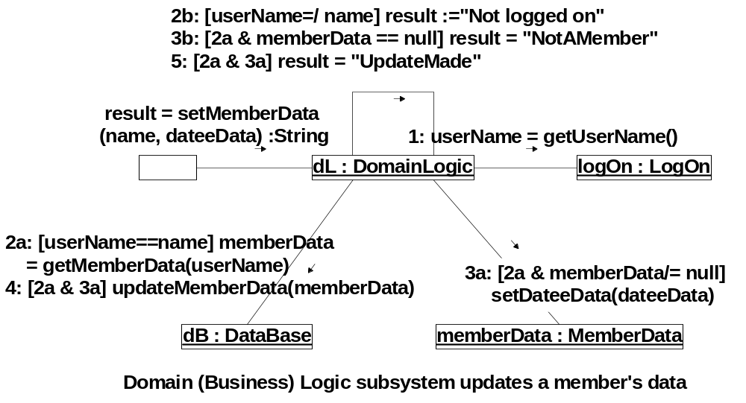
Copyright W. Howden

Slide 8
Message Sequence Notation
Don’t number first message, we are showing how the object responds to this initial event
Complicated situations:
  Conditional branching
  Nesting of (sub) operations
  Compound conditionals
Copyright W. Howden

Slide 9
Notation: Conditionals
Alternative choices of message flows
  1. Precede messages with constraints/guards
    E.g. [userName == name] …….
  2. Use lettered notation to indicate alternative message flows
    E.g. 2a, 2b; 3a, 3b in the example
Copyright W. Howden

Slide 10
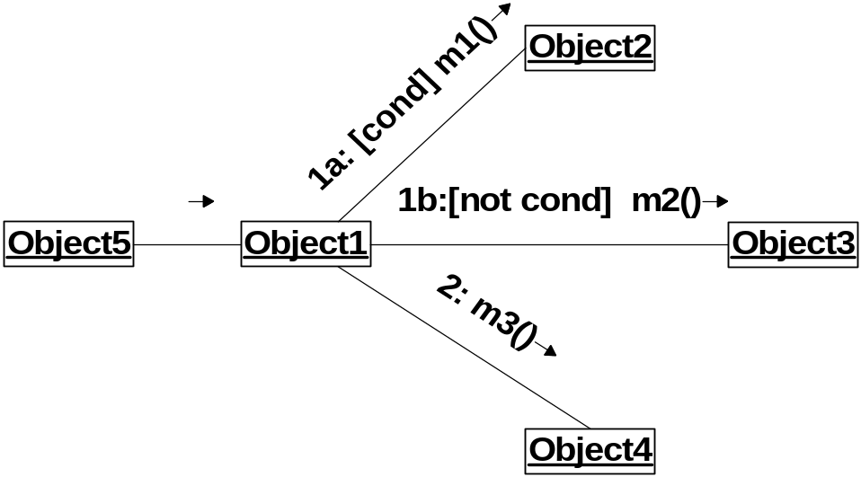
Conditionals Example
Used to indicate choices based on specified conditions. Either 1a or 1b is done, then 2 is done
Copyright W. Howden

Slide 11
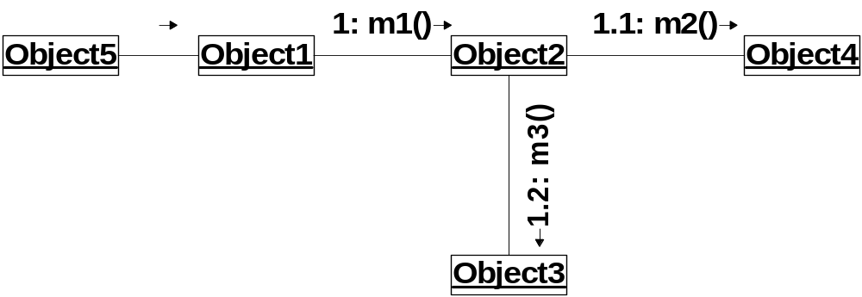
Nesting and Sub-Operations
Nested inside the response to message m1, is the sending of messages m2 then m3, done before “returning” from m1
Copyright W. Howden

Slide 12
Compound Conditions
How to number structures such as?
  if a then
  if b then {c, d}
  else e
  else g
Nested numbering already used up for sub-operation nesting so just repeat the condition
Copyright W. Howden

Slide 13
Copyright W. Howden

Slide 14
Notation - Names
Lower case
  Specific: objects, messages, instances instances, instance variables
Upper Case
  General: Classes, Types, Associations in Domain Models
Copyright W. Howden

Slide 15
Copyright W. Howden

Slide 16
Notation - Iteration
Use star notation to indicate repetition of a message
  Iterated sequence of messages: match iterated conditions, possible ambiguity
Stacked icons indicate object collections
Additional notation: anonymous objects
Copyright W. Howden

Slide 17
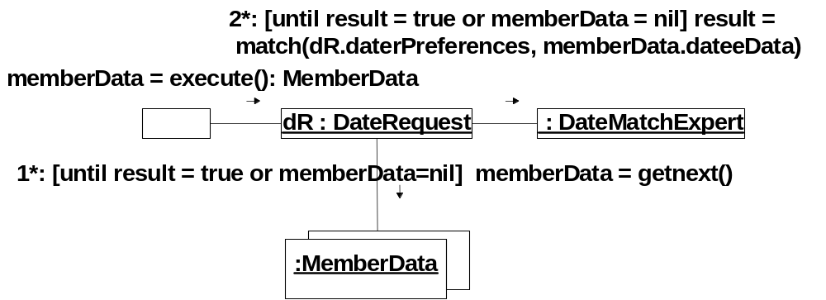
Copyright W. Howden

Slide 18
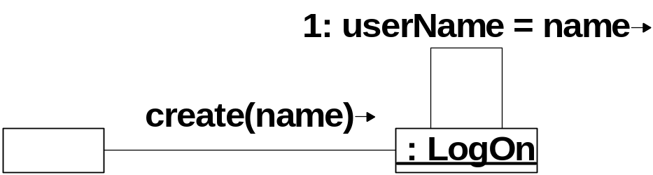
Notation: Object Creation
Diagrams show messages from one object to another
How to show creation of an object?
Notational convention: send it a create message
Copyright W. Howden

Slide 19
Discovery of Classes and Methods
Collaboration Diagrams show objects for which we will develop classes
Messages that are sent to Classes/Objects will be methods in the classes
Copyright W. Howden

Slide 20
Collaboration Diagrams for DS
Assume three level design: GUI, DL (Business or Domain Logic) and DB (Data Base)
Assume a single interface class for each subsystem: GUI, DL, DB
Start with DL
Copyright W. Howden

Slide 21
Domain Logic Classes
Start with interface class DomainLogic
During construction of collaboration diagrams
  Discover new, needed methods for the class
  Create new classes/objects needed to help fulfill some responsibility
Copyright W. Howden

Slide 22
Domain Logic Event Responses
Events/messages to be handled by dL (Domain Logic Interface)
  logOn()
  getUserType()
  getCurrentUName()
Design choices shown on following collaboration diagram
Copyright W. Howden

Slide 23
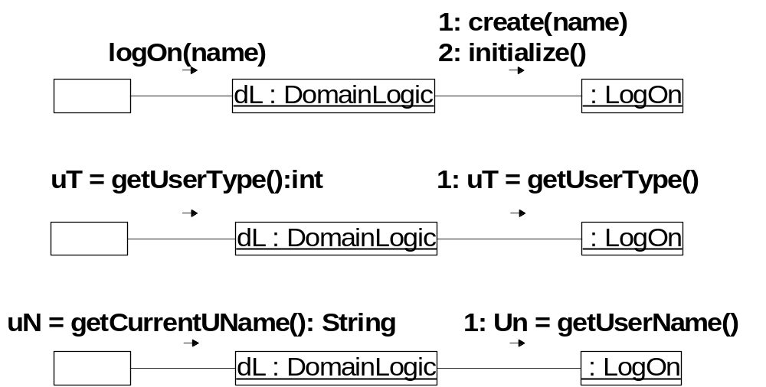
Copyright W. Howden

Slide 24
Expert & Creator Pattern Uses
  DL creates LogOn because it has the initialization data, and records instances of LogOn event
  LogOn will have the information necessary to determine user type, so it will be given this expert responsibility
  It has the information necessary to determine the name of the logged on user so will have this responsibility also
Copyright W. Howden

Slide 25
More DL Event Responses
dL will have to deal with the following event/messages
  getDate()
  isMemberber()
  getMemberData()
Design Choices shown on following diagram
Copyright W. Howden

Slide 26
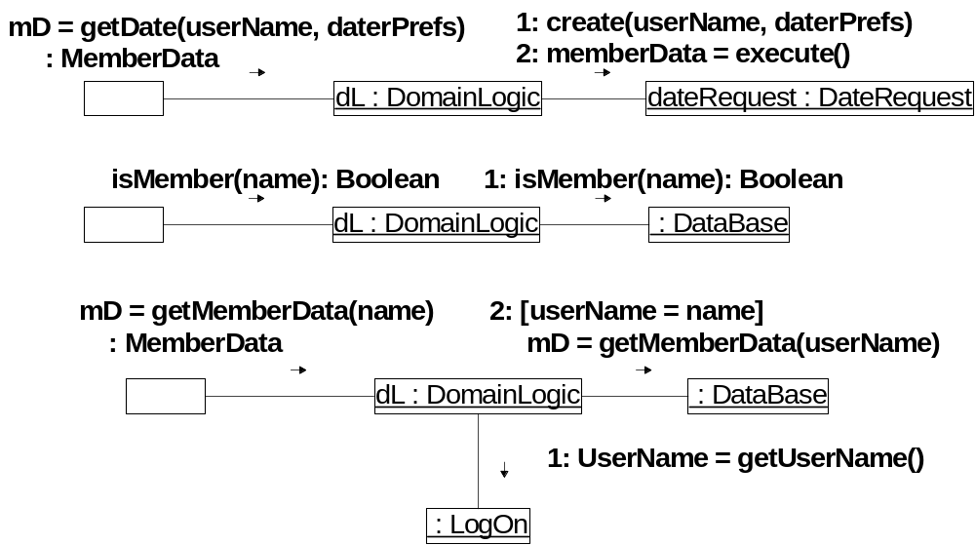
Copyright W. Howden

Slide 27
Expert and Creator Pattern Uses
  DL creates LogOn because it has the initialization data and records instances of LogOn event
  LogOn will have the information necessary to determine user type, so it will be given this expert responsibility
  It has the information necessary to determine the name of the logged on user so will have this responsibility also
Copyright W. Howden

Slide 28
More Complex Diagrams
Following slide shows dL response to setMemberData() event/message
Interfaces with both its own subsystem classes and other subsystem interface
Copyright W. Howden

Slide 29
Copyright W. Howden

Slide 30
Design Decisions for DomainLogic
Necessary DomainLogic methods
  logOn, getCurrentUName, getUserType
  getDate, isMember, getMemberData
  setMemberData
New objects/classes created
  LogOn, DateRequest, MemberData
Copyright W. Howden

Slide 31
Designing Subsystem Classes
LogOn is one of the classes we decided to create inside the DomainLogic subsystem
The dL interface class for DL sends messages to this class
How will it respond to the event/messages it must take the responsibility for?
Shown in following Collaboration diagrams
Copyright W. Howden

Slide 32
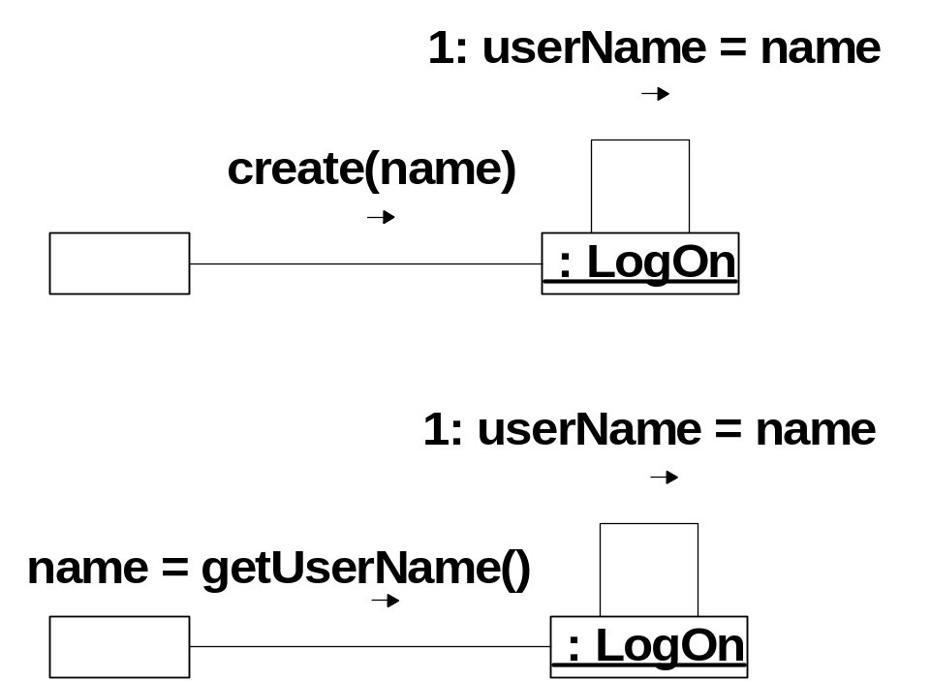
LogOn Class
Copyright W. Howden

Slide 33
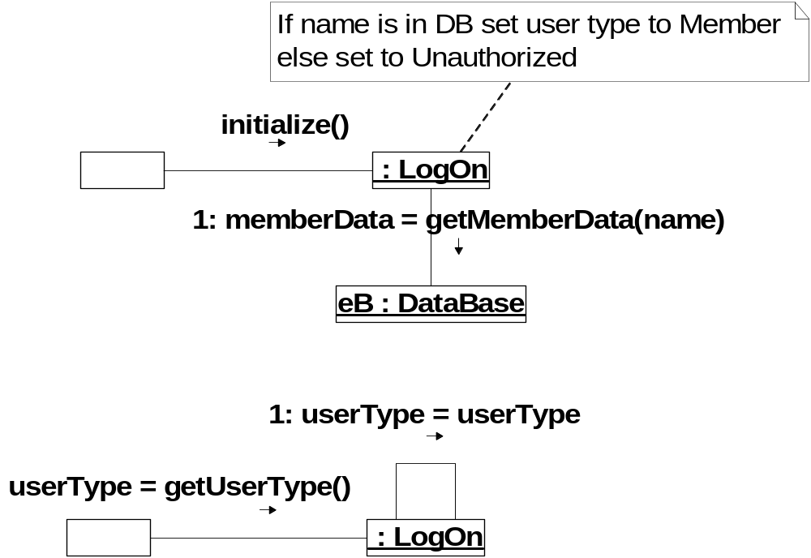
Copyright W. Howden

Slide 34
Design Decisions for LogOn
LogOn methods
  create(name)
  getUserName()
  initialize()
  getUserType()
Copyright W. Howden

Slide 35
DL Design Motivation
Where did these objects and these ideas for the design come from?
1. Messages sent from GUI
  GUI collaboration diagrams show GUI will respond to user initiated events identified in sequence diagrams
2. Principles of good design
  2.1 Design evaluation
  2.2 Design patterns
Copyright W. Howden

Slide 36
GUI Classes
Start with GUI interface class
Collaboration Diagrams
  Discover needed methods for the class
  Create new classes/objects needed to help fulfill some responsibility
Copyright W. Howden

Slide 37
Collaboration Diagrams and User Interface Design
Messages are a little different
  Come from
    actor actions such as pressing a button
    other GUI objects which may create them and send a message to become visible
Following (partial) set of diagrams does not deal with case where user is ADMIN
Copyright W. Howden

Slide 38
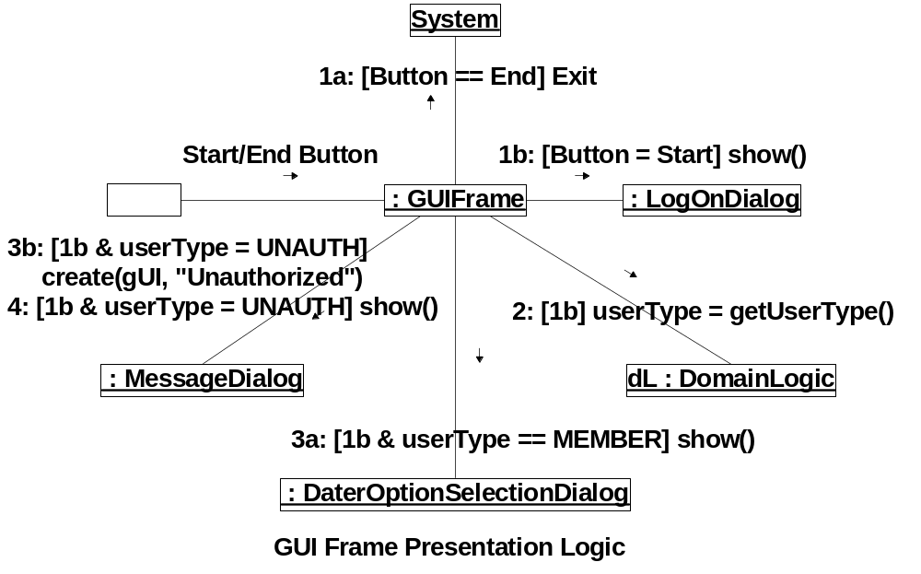
Copyright W. Howden

Slide 39
Design Decisions for GUI
New Classes
  Objects appearing in GUI collaboration model
    MessageDialog, LogOnDialog, DaterOptionSelectionDialog
  When made visible (with show()) a GUI object can respond to events
    Additional collaboration diagrams will show their responses, and additional classes
Copyright W. Howden

Slide 40
More GUI Collaboration Diagrams 1
Diagrams for Classes that receive messages/events from :GUIFrame
Shows their responses to events
  from actors
  from other GUI objects
Copyright W. Howden

Slide 41
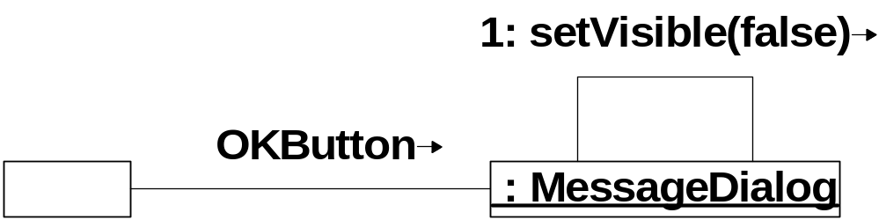
Copyright W. Howden

Slide 42
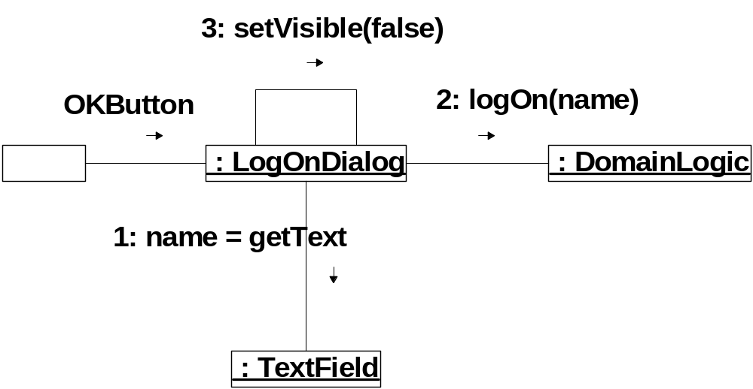
Copyright W. Howden

Slide 43
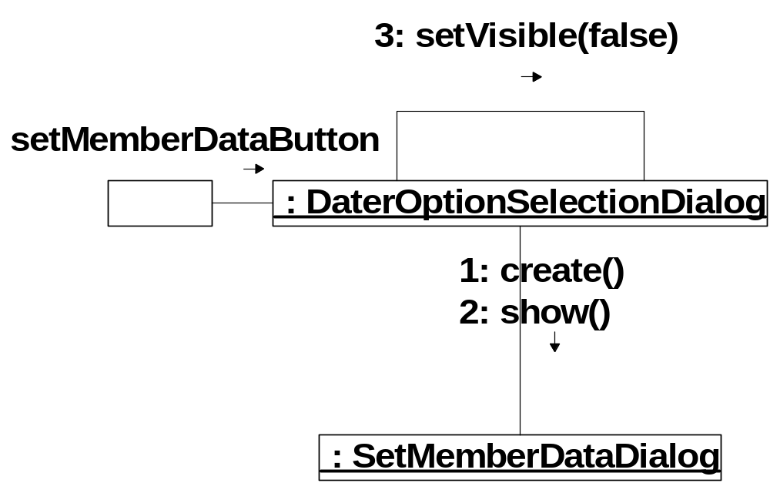
Copyright W. Howden

Slide 44
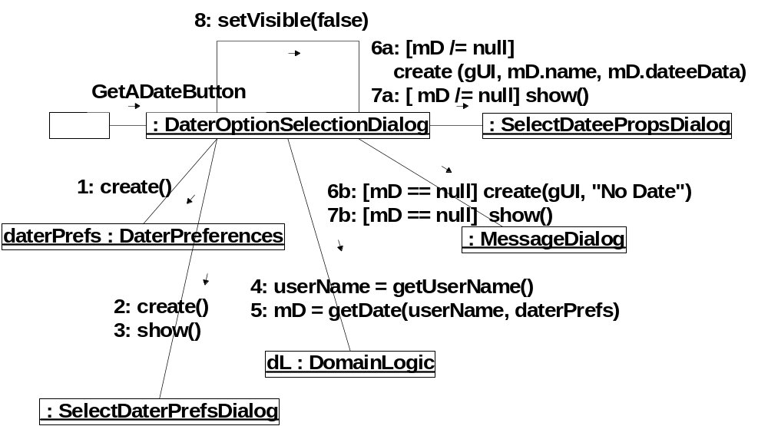
Copyright W. Howden

Slide 45
Design Decisions for DaterOptionSelectionDialog
New Classes for setMemberData message
  SetMemberDataDialog
New Classes for getADateButton message
  SelectDaterPrefsDialog, MessageDialog, SelectDateePropsDialog, DaterPreferences
Copyright W. Howden

Slide 46
More GUI
Collaboration Diagrams 2
Collaboration diagrams for classes receiving messages/events from classes that receive messages/events from GUIFrame
  From DaterOptionSelectionDialog
    setMemberDataButton alternative
      SetMemberDataDialog
    getADateButton alternative (only first is shown)
      SelectDaterPrefsDialog, MessageDialog, SelectDateePropsDialog, DaterPreferences
Copyright W. Howden

Slide 47
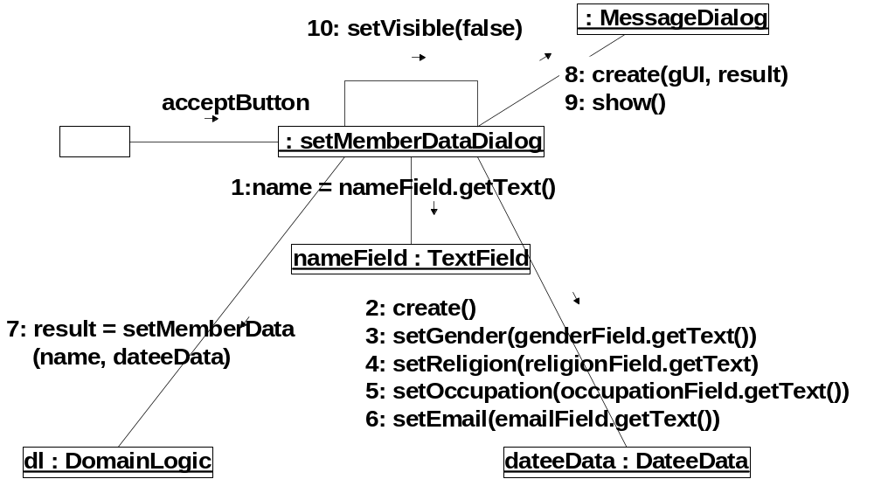
Copyright W. Howden

Slide 48
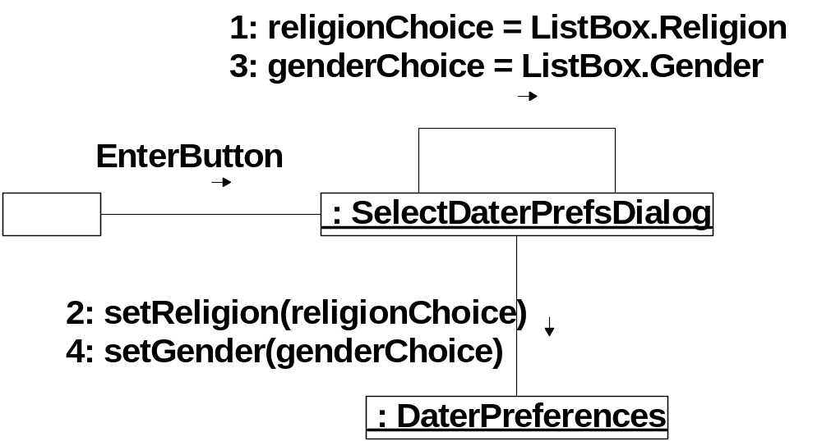
Copyright W. Howden

Slide 49
Design Decisions
SetMemberDataDialog
  New Classes
    DateeData
      necessary methods
SelectDaterPrefsDialog
  additional methods for daterPreferences
    setReligion, setGender
Copyright W. Howden

Slide 50
Additional GUI Diagrams
GUIFrame, for full set of functionality, will need a branch for UserType = ADMIN
This will send a show() message to an object called
  AdminOptionSelectionDialog
leading to new classes and additional collaboration diagrams
Copyright W. Howden

Slide 51
Collaboration vs Sequence Diagrams
Equivalent: it is possible to transform one kind of diagram into the other
  Rational Rose: automated tool
Sequence diagrams: clearly show
  ordering of messages in time
  linear interaction structure
Collaboration
  good for free form create of new messages and classes during design process
Copyright W. Howden

Slide 52
Assignment 5
Construct collaboration diagrams for your subsystem interface classes (Phase 1)
Construct collaboration diagrams for the more complex classes that are created by the subsystem interface classes (and more complex ones created by them, ....)
Copyright W. Howden

